Slide 1
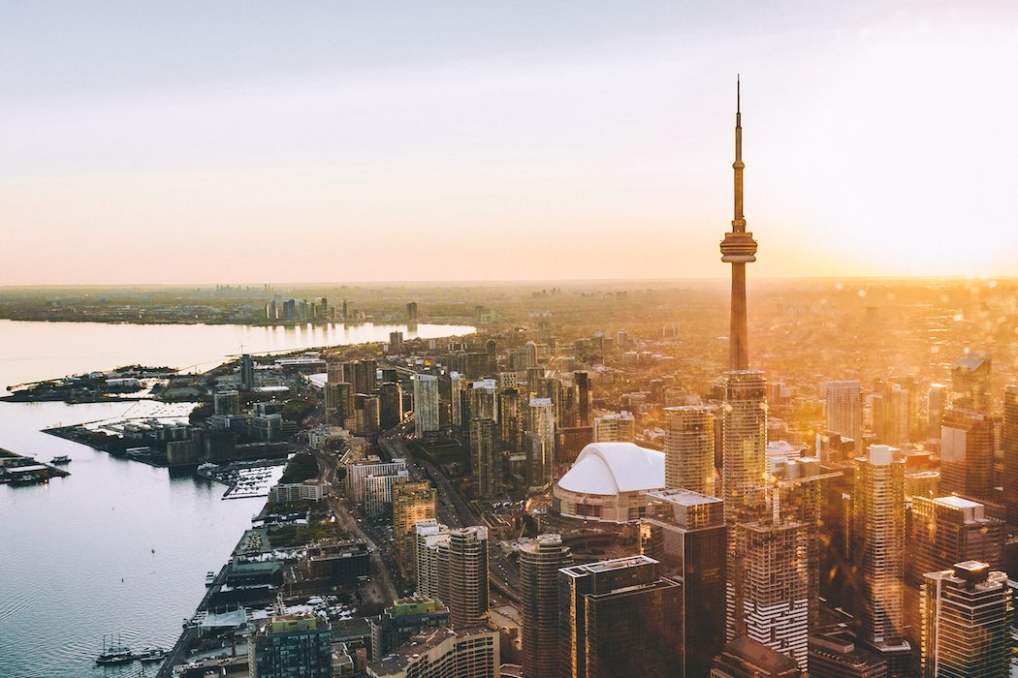
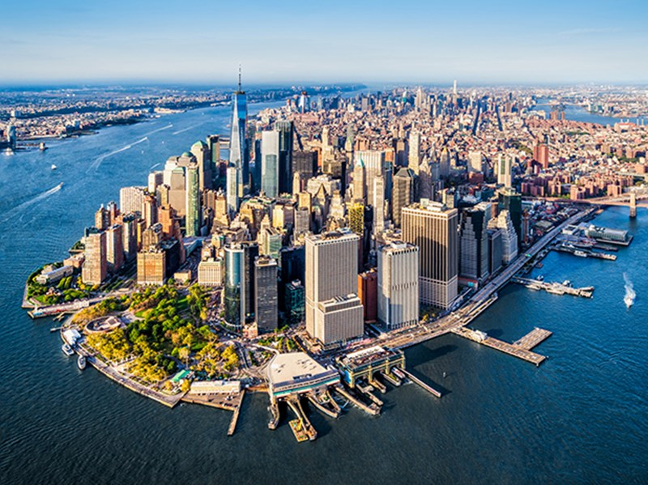
Comparing Neighborhoods in Downtown Toronto and Manhattan: Are the Top trending venues similar?

Slide 2
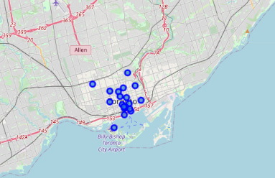

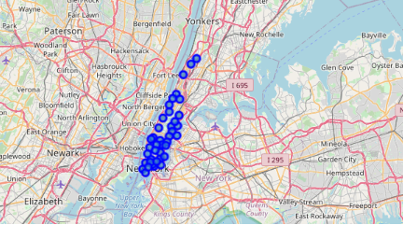
Introduction
The analysis compares the two most central Boroughs in Toronto and New York City. Are citizens and tourists in the two ci similar in terms of preferred venues, consumption preferences and habits?
It will start by identifying all the Neighborhoods belonging to the two Boroughs and then running a cluster analysis on the Top Trending Venues.

Slide 3
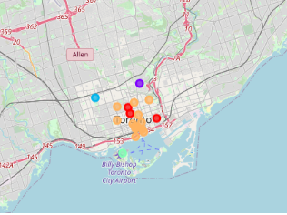
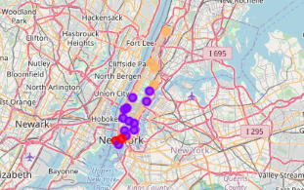
Cluster Analysis Results
The results of the Cluster Analysis show a different structure of Clusters in Downtown Toronto, compared to Manhattan…

Slide 4
Clusters Downtown Toronto
Central Area 1 – Orange Cluster
Central Area 2 – Red Cluster
Airport – Green Cluster
Rosendale Neighborhood – Purple Cluster
Christie Neighborhood – Blue Cluster

Slide 5
Clusters Manhattan
South – Red Cluster
Central – Purple Cluster
Nortth and Chinatown – Orange Cluster

Slide 6
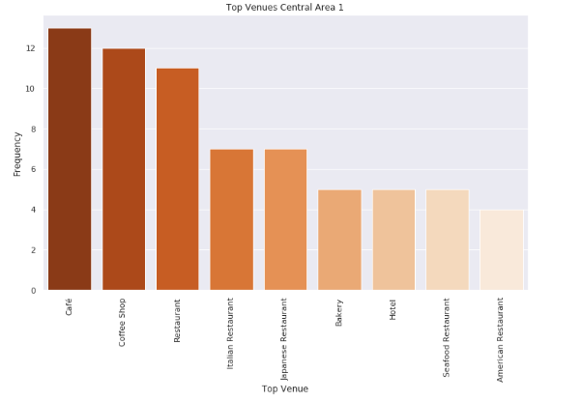
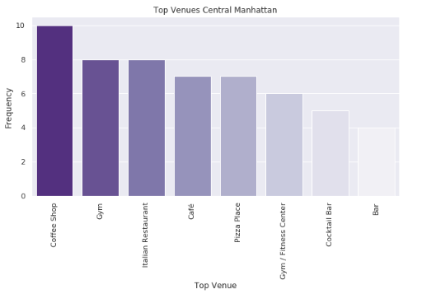
Downtown Toronto Central Area 1 vs Manhattan Central
Central locations of the two Boroughs shows similar patterns in terms of types of Activites. These are the most central areas in the two boroughs and the most active in terms of business, nightlife and Touristic Activities.
Top trending venues in Central Area 1 in Downtown Toronto and Central in Manhattan are mostly related to Horeca sector with Coffee shops as the most top rated activities in the two Clusters.

Slide 7
Conclusion
Preferences Central Area 1 are for a wider range of restaurants, while in Manhattan preferences are for Pizza Places and Italian Restaurants. There are also more Top rated Hotels in Toronto Central compared to Manhattan.
Downtown Toronto seems a more heterogeneous Borough. Neighborhoods away from the center are really different in terms of top venues and seem more residential. There is also an Airport area.
Although Clusters in Manhattan are dissimilar in terms of Top venues, we can see similar patterns between them, mostly dominated by Horeca sector. Gyms in Manhattan are more appreciated while citizens in Downtown Toronto seem more inclined to Outdoor Activities.

